Slide 1
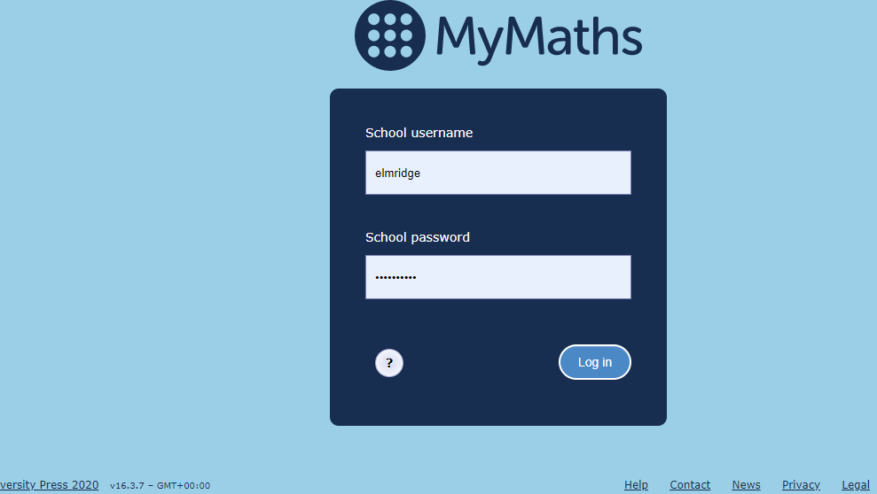
Notes:
Enter the school username: elmridge
Enter the password: tangent220

Slide 2
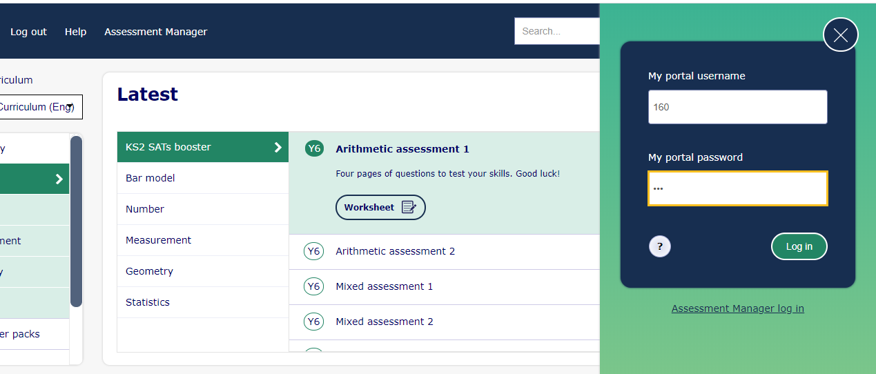
Notes:
Click ‘My Portal Log In’ in the top right if the box doesn’t appear automatically.
Children have been emailed their username and password on Purple Mash (Tools, 2email, 2email)

Slide 3
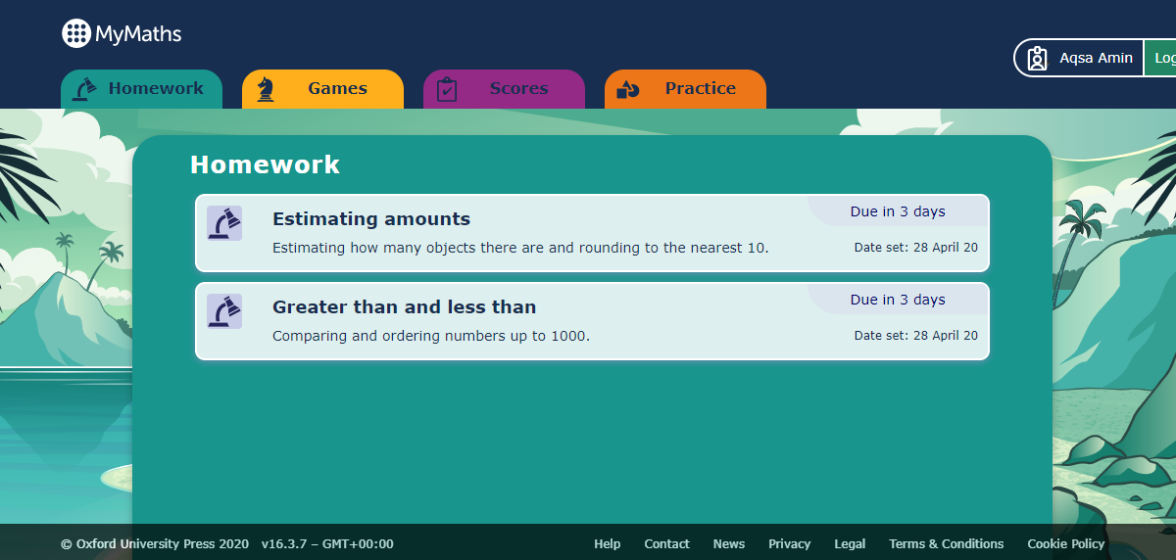
Notes:
This is the screen that will load. It shows the tasks set for your child.

Slide 4
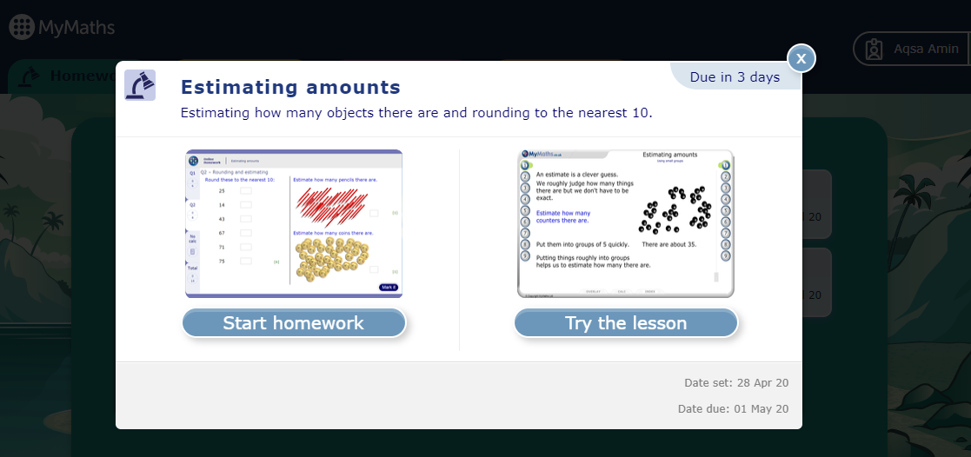
Notes:
When you click on a task, you get two options. Try the lesson talks the children through how to solve the question and allows them to practise first.
Start the homework takes them straight to the task.

Slide 5
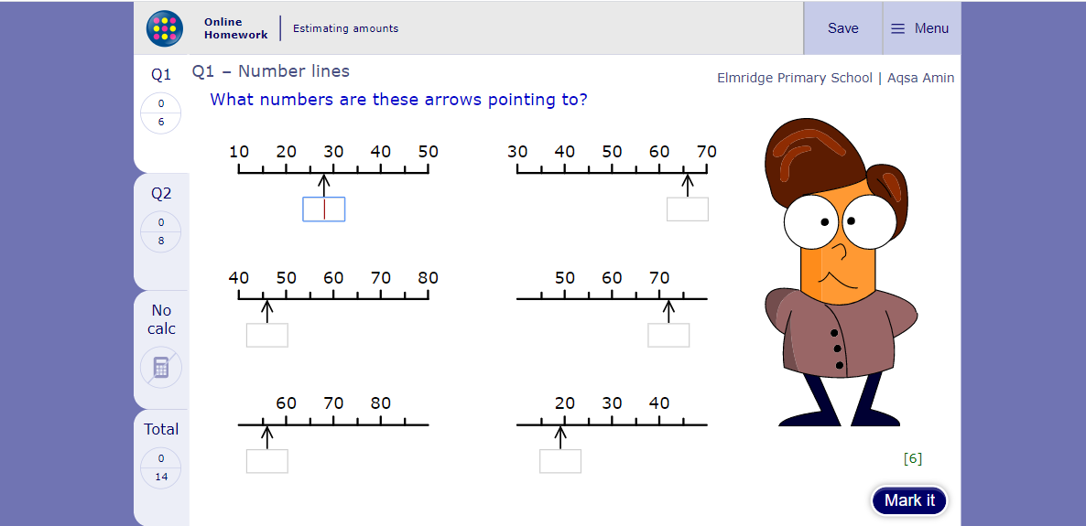
Notes:
When the children have filled the empty boxes, they need to click mark. If they are half way through a task and want to save, they just need to click save. They need to go back to the task and complete it for it to save and register with their class teacher.

Slide 6
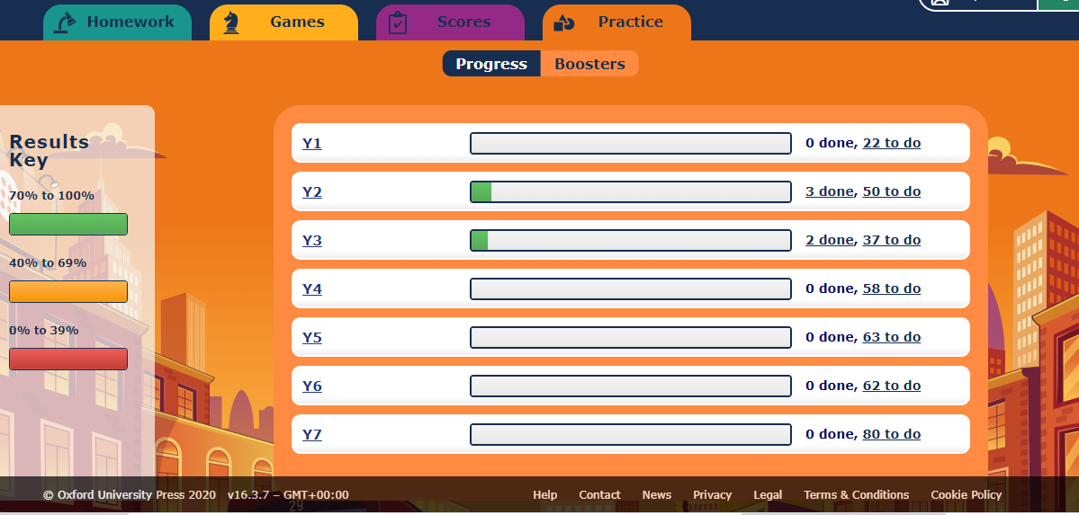
Notes:
If the children click ‘Practice’, they will find lots of tasks they can use when they like. If they click on their year group or below, it will bring up activities that match their year group. It will bring up ‘Start Homework’ or ‘Try the Lesson’.

Slide 7
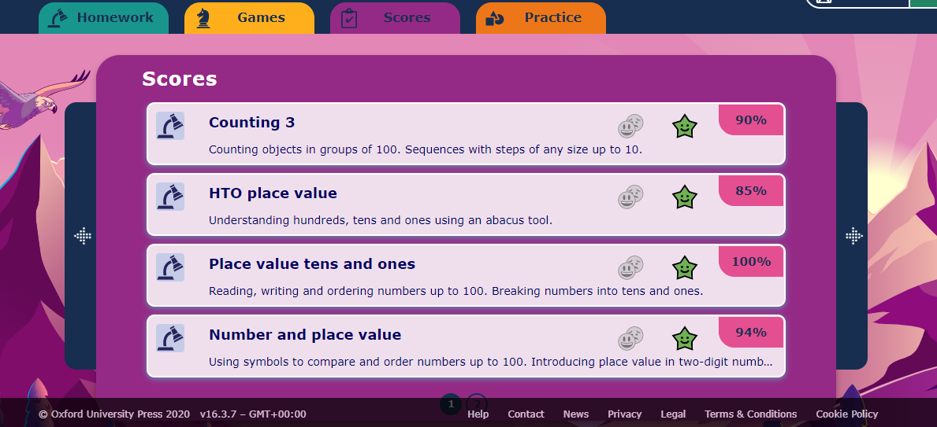
Notes:
The scores section has all the previously completed tasks. Children can repeat the task if they want to. They need to click the task, they can ‘Try the homework’ or do the lesson.

